Slide 1
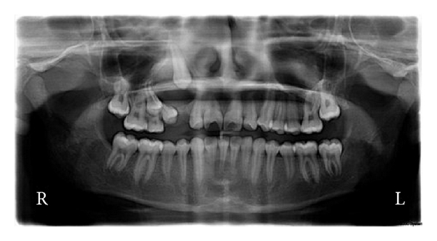
Adenomatoid odontogenic tumor
(AOT)
RITU KUMARI
(BDS 3RD YEAR)

Slide 2
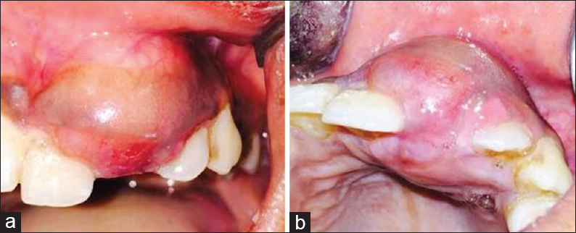
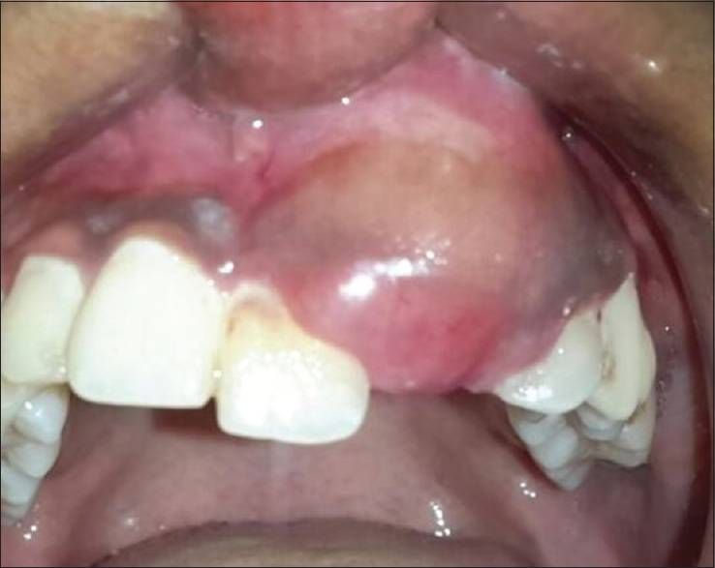
CLINICAL FEATURES
PERIPHERAL VARIENT
OF AOT
(small sesile growth on gingiva)

Slide 3
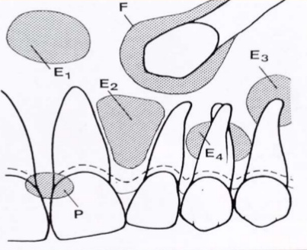
RADIOGRAPHIC FEATURES
FORMS OF AOT:
FOLLICULAR (F)
EXTRA-FOLLICULAR (E)

Slide 4
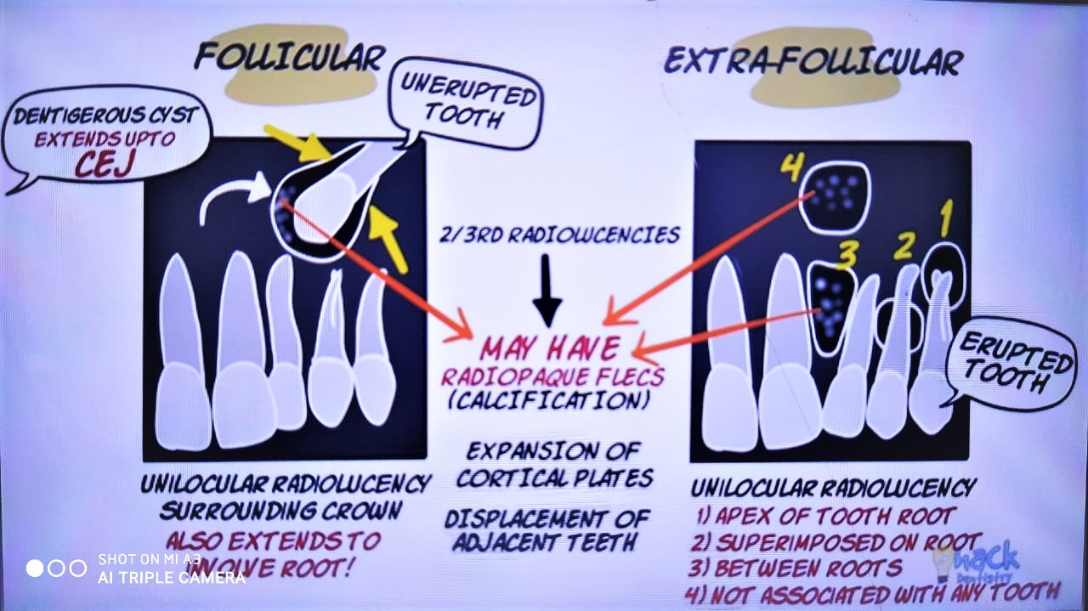

Slide 5
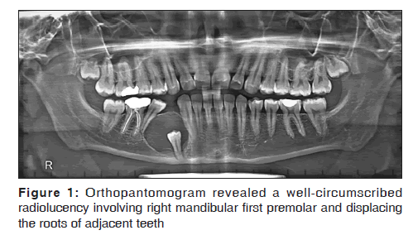
Orthopantomogram revealed a well-circumscribed radiolucency involving right mandibular first premolar and displacing the roots of adjacent teeth

Slide 6
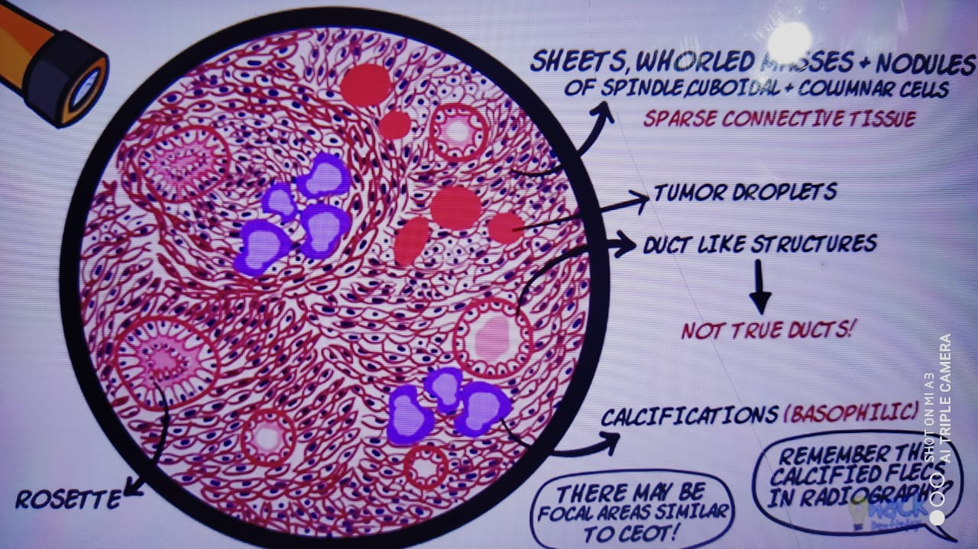
HISTOPATHOLOGY

Slide 7
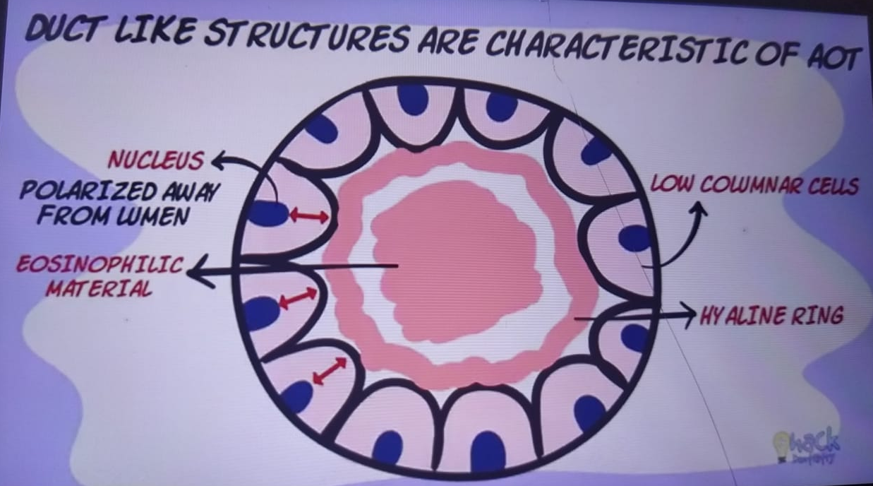

Slide 8
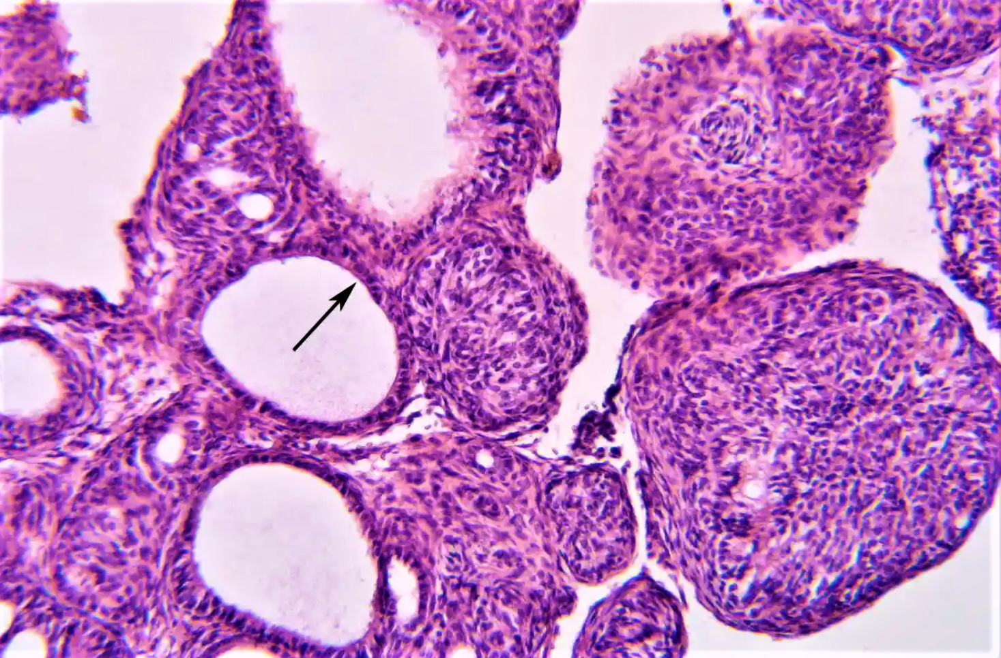
DUCT LIKE
STRUCTURE

Slide 9
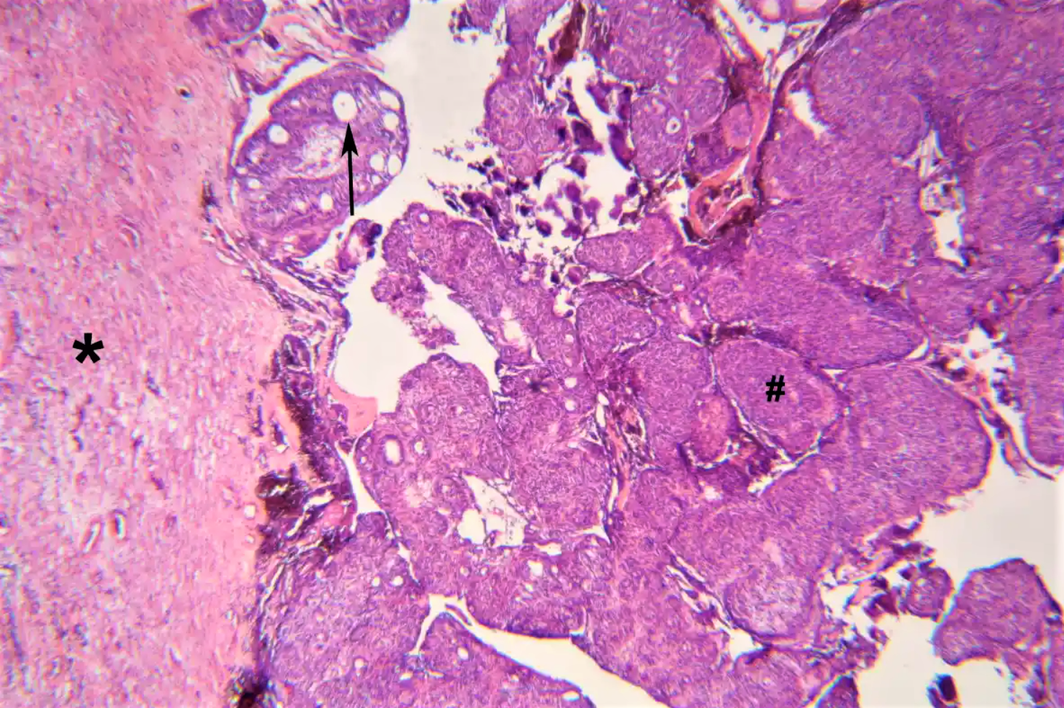
*
TUMOR WITH FIBROUS
CONNECTIVE TISSUE CAPSULE
#
NODULAR AGGREGATE OF CELLS
→
DUCT LIKE STRUCTURE

Slide 10
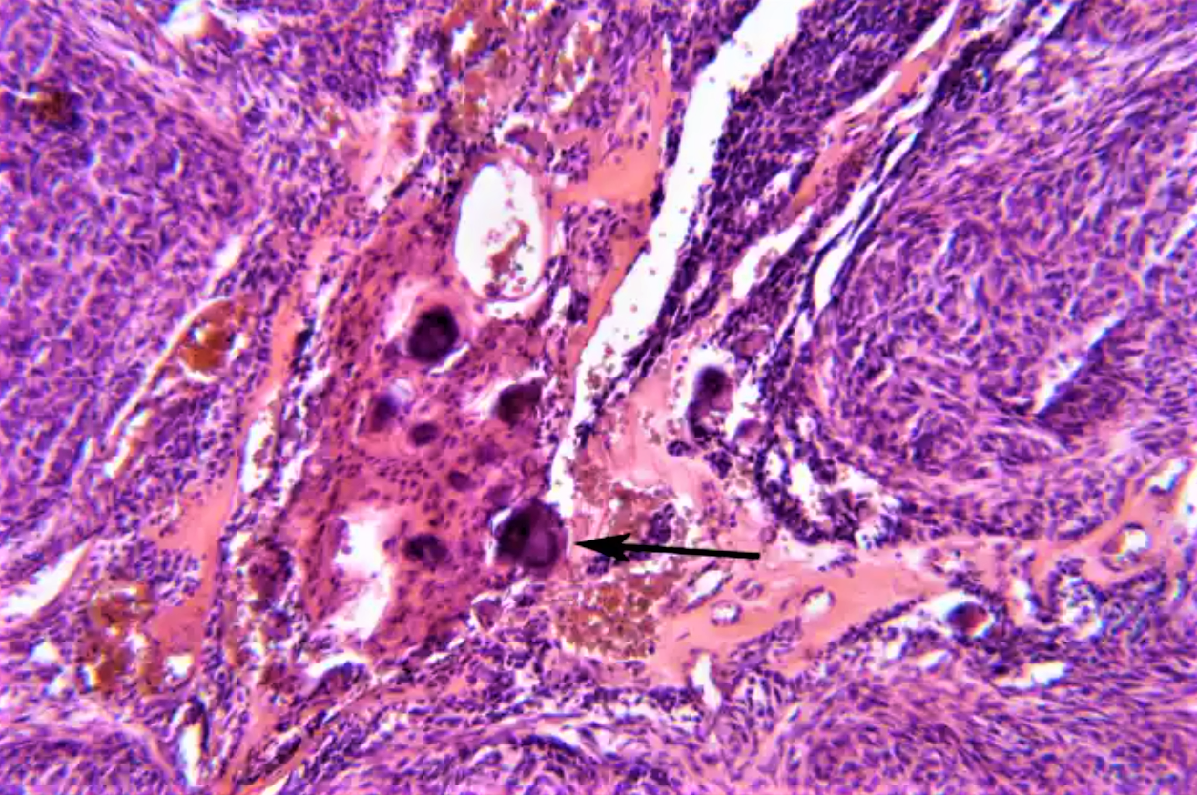
FOCI OF CALCIFIED MASS

Slide 11


Slide 12
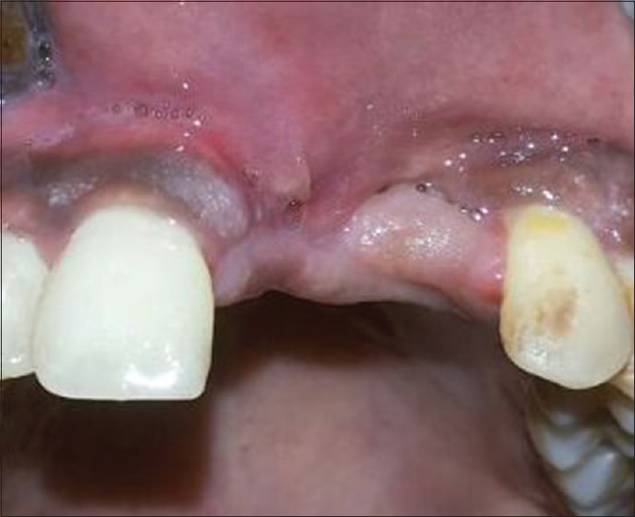
→

Slide 13
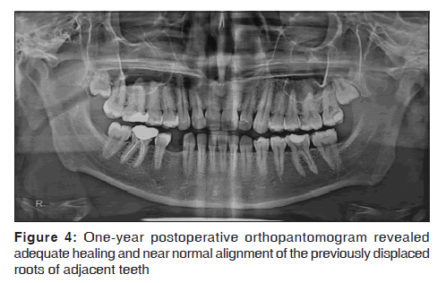
ORTHOPANTOMOGRAM REVEALED A WELL-CIRCUMSCRIBED RADIOLUCENCY INVOLVING RIGHT MANDIBULAR FIRST PREMOLAR AND DISPLACING THE ROOTS OF ADJACENT TEETH
ONE-YEAR POSTOPERATIVE ORTHOPANTOMOGRAM REVEALED HEALING AND NEAR NORMAL ALIGNMENT OF THE PREVIOUSLY DISPLACED ROOTS OF ADJACENT TEETH

Slide 14
THANK YOU

